Slide 1
Healthy Relationships
What can turn a healthy relationship into an unhealthy one and how do you know its unhealthy?
We have just spent a half term talking about your future career and researching on unifrog. Name two ways that you could keep healthy relationships with people you might work with in the future?
What things would make those work relationships more difficult or unhealthy?

Slide 2
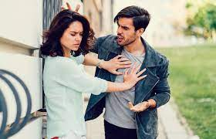
Can you use these words in your answer?
New Vocabulary
Consent, Conflict, Unhealthy, Abusive, Relationship, Boundaries
Does this look like a healthy relationship. WHY, can you use the words in the box?
Notes:
TEACHER NOTES & IDEAS
Remind students of the learning journey (What theme you are doing – Possibly recap what they can remember from last lesson.
ATTRIBUTION AND COPYRIGHT
– All icons and logos for Cre8tive Curriculum are created Inhouse by Michael Gillman ©
All images are sourced correctly – mainly through the following sites
either Premium licence at https://www.freepik.com/ or www.Pixabay.com or https://www.pixelscrapper.com/help
Some image have purchased also.
Factual information is not copyrighted.
Where information has been taken from reliable 3rd party websites – it is done so for analytical purposes in small pieces of text and for educational purposes.
Always check the content of any lesson and videos linked before teaching to ensure suitability for your classroom and your school
Further Terms and Condition regarding Copyright and our terms of use can be found on our website here https://cre8tiveresources.com/terms-of-use/

Slide 3
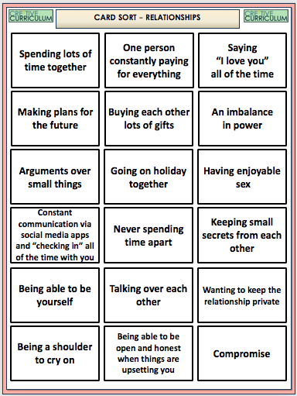
Relationships
Task
Think about each statement and label them into the three categories
Extension when all glued in
Can you explain why you have put some in the middle. What does it depend on?
Unhealthy Relationship
Healthy Relationship
Mixture of both

Slide 4
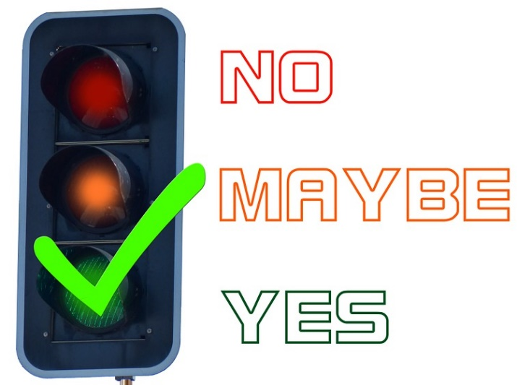
Healthy Relationship or Not?
TASK
Work out if each scenario is Green (Healthy) Amber (Somewhat healthy) or Red (Completely unhealthy) (Click below for colour to appear)
THE HEALTH CALCULATOR
1
2
Your partner buys you lots of gym wear for your birthday because they want you to lose weight
Partner one wants to have sex. Partner two says they’re not ready, but after talking about it, gives in and has sex, even though they didn’t really want to.
3
5
4
A couple has an agreement that they won’t put passwords on their mobile devices and they will connect each others social media account to both their phone and their partners phone.
Two people have been together for twelve months, and things haven’t been going so well. One person decides to start flirting with other people on social media behind the other ones back.
A boy notices his girlfriend is getting a lot of attention from a few different people in their friendship group. He goes up to each of them separately and warns them to stay away “or else.”

Slide 5
Pick out 3 points from the video about heathy relationships
Notes:
TEACHER NOTES & IDEAS
If the Video is short it may be worth playing it twice – 1st time let students watch carefully and 2nd time have students complete one or two of the hats
Short of Time – Play the video and Answer A few of the hats afterwards as a class
N.B This is a generic slide and sometimes the hats may not be appropriate for the video clip (if so delete or change accordingly to suit)
N.B Always check the video link is age appropriate to your class before showing student in the lesson.

Slide 6
Instructions: Pick a number and you have 1 minute to debate the topic
Being in a Relationship is better than being Single
Dumping someone is easy to do
The age of sexual consent is right at 16
Battle Point– [Click to Reveal]
No. 1
Battle Point– [Click to Reveal]
No. 2
Battle Point– [Click to Reveal]
No. 3
Whatever the topic is one person has to make a point to start the debate and the other person has to come up with a counter argument (even if they agree with the first point).
Relationships should always be equal in power
Battle Point– [Click to Reveal]
No. 5
Battle Point– [Click to Reveal]
No. 6
Battle Point– [Click to Reveal]
No. 4
Age shouldn’t be an issue in a relationship
Relationships with friends are more important than boyfriend/girlfriends
1 Minute!
TIME’S UP
1 Minute!
1 Minute!
TIME’S UP
TIME’S UP
1 Minute!
1 Minute!
TIME’S UP
TIME’S UP
1 Minute!
TIME’S UP
START
TIMER
START
TIMER
START
TIMER
START
TIMER
START
TIMER
START
TIMER

Slide 7
Are different relationships different, do we show we care and create healthy relationships in different ways?
Task 1 - How do these people show they care for each other and the ways they show it different?
• Two adults who are married
• Two 17 year olds who fancy each other
• A grandparent and their grandchildren
A teenager and her bestie
An employer and their employee
Mother and daughter
• Two 14 year old boys who are just good friends.
Discuss them all and pick 2 or more to write about

Slide 8
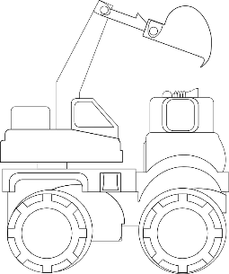
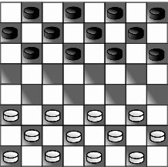
WHAT DO YOU THINK?
Talking points
I think that …
I don’t think… is right because…
My opinion is…
I would argue the same because…
I disagree with… because
Building on what ….
An alternate way of looking at this is…
I sort of agree, however….
In my view…
I would challenge what… said because …
“Year 8’s are too young to fall in love with someone”
?
AGREE
ALTERNATE IDEA
DEVELOP
Disagree
Challenge
Alternative
Idea/option
DISAGREE
Develop
CHALLENGE
Notes:
TEACHER NOTES & IDEAS
Ask students what they think of this image (collection of images)
Reveal the talking points after some discussion time
To provoke discussion with a quiet class – play devils advocate
Challenge a student to a debate

Slide 9
WHAT DO YOU THINK?
Talking points
I think that …
I don’t think… is right because…
My opinion is…
I would argue the same because…
I disagree with… because
Building on what ….
An alternate way of looking at this is…
I sort of agree, however….
In my view…
I would challenge what… said because …
The big question
What can turn a healthy relationship into an unhealthy one and how do you know its unhealthy?
?
AGREE
ALTERNATE IDEA
DEVELOP
Disagree
Challenge
Alternative
Idea/option
DISAGREE
Develop
CHALLENGE
Notes:
TEACHER NOTES & IDEAS
Ask students what they think of this image (collection of images)
Reveal the talking points after some discussion time
To provoke discussion with a quiet class – play devils advocate
Challenge a student to a debate

