Slide 1
Puberty and girls
Do you understand what happens to girls during puberty and how the changes can affect body image and self esteem?
From last week, can you name 2 changes that happen to boys that also happen to girls?

Slide 2
Changes in Girls
Will all this happen at the same time?
Your nipples and breasts will get bigger (you might wear a bra).
You will grow pubic hair.
Your body shape may grow more curvy and your hips may get wider.
You might start to get vaginal discharge - clear/milky liquid in your underwear which keeps the vagina healthy.
Your periods will start at some point.
You will grow taller
What happens to girls and boys? Think back to last week?
Notes:
Your nipples and breasts will get bigger (you might wear a bra).
Your body shape may grow more curvy and your hips may get wider.
You might start to get vaginal discharge - clear/milky liquid in your underwear which keeps the vagina healthy.
Your periods will start. – we are going to learn about this more in the next activity

Slide 3
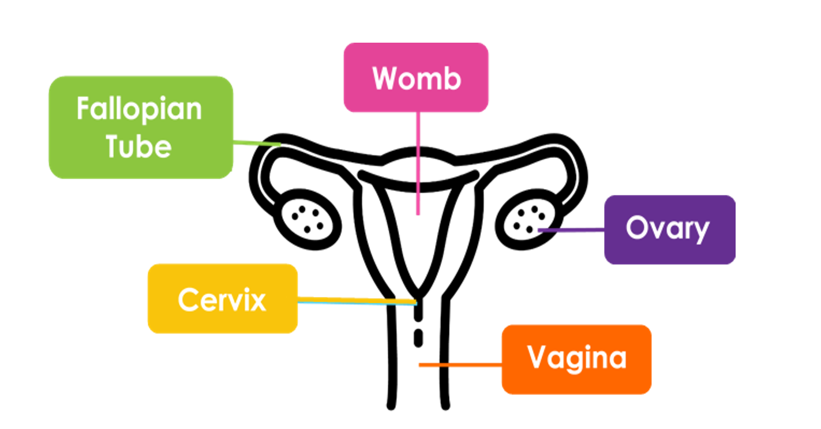
Glue in your handout sheet and label the parts of the female anatomy – do you remember this from science?
Or Uterus

Slide 4
Watch the video and then your teacher will talk you through it again with the diagram and answer your questions

Slide 5
Glue in your handout sheet and label the parts of the female anatomy – do you remember this from science?
Or Uterus

Slide 6
Periods or Menstruation
Every month (ish), the ovaries release an egg – this is called ovulation. If this egg is not fertilised by a sperm, the egg does NOT embed in the uterus and instead comes out through the vagina, and this is what period blood is. A period will usually last for two to ten days.
Notes:
•Every month (ish), the ovaries release an egg – this is called ovulation. If this egg is not fertilised by a sperm, the egg disperses in the uterus and comes out through the vagina as blood. A period will usually last for two to ten days.
•In this session, we will be using the terms ‘period’ and ‘menstruation’, because they mean the same thing. Menstruation is the scientific term for a period.

Slide 8
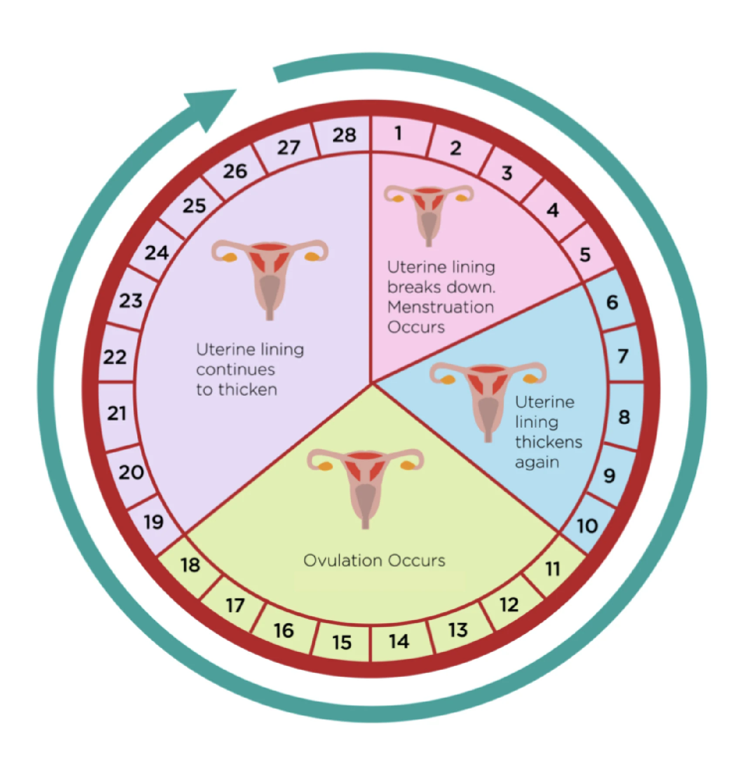
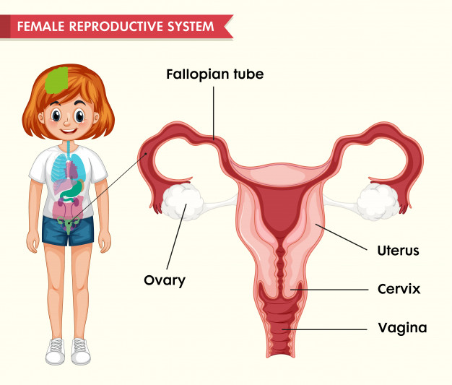
Menstrual cycle
So each month the blood that is released from a girls Uterus is the lining of the uterus and the unfertilised egg.
What happens if a girl has had sex with a boy and her egg HAS been fertilized?
Notes:
•In this session, we will be using the terms ‘period’ and ‘menstruation’, because they mean the same thing. Menstruation is the scientific term for a period. They are triggered by hormones released from the brain during puberty
•The average age to start is 12 but most people’s periods start between 8 and 14. If you have not started your period by the time you are 18 it is a good idea to speak to a doctor.
•Periods are part of the menstrual cycle. Day 1 of the menstrual cycle is the day that you get your period, and the menstrual cycle lasts until the day before your next one. Some people’s cycle may last away between 21 and 40 days
•A new egg grows and matures between days 6 and 12 of the menstrual cycle
•Around day 13 or 14 of the cycle the ovaries release an egg – this is called ovulation.
•Post ovulation is the time after the egg is released.
•If this egg is not fertilised by a sperm, the egg disperses in the uterus and comes out through the vagina, and this is what period blood is.
•There’s no ‘normal’ period or cycle, everyone is different! But usually they last a few days (commonly 3-8 days) passing between 5-12 teaspoons of pink, red or brown blood – this can be can be thick or watery. Periods can be irregular, heavy or light and can change throughout your life.
•It’s normal to get vaginal discharge throughout the month. The amount that comes out can vary, depending on where you’re at in your menstrual cycle. Sometimes discharge looks thick and white, and other times (when you’re releasing an egg, around ovulation) it looks stringy and clear. It can also have a yellowish look to it. The point of discharge is to keep the vagina moist, clean and healthy. It cleans the vagina by getting rid of dead cells and bacteria. So it is nothing to worry about, in fact it’s a sign everything is healthy and working as it should. If your vaginal discharge changes colour, consistency or smell this may be the sign of an infection, so it’s important to speak to a doctor.
•Use plain, unperfumed soap every day to gently wash your vulva. Never clean inside the vagina (douche) as it washes out the good bacteria. Always wipe front to back, to avoid transferring bacteria from the anus.

Slide 9
Tracking your cycle
Tracking your cycle can help you learn about your body and how you might feel at different stages. You might see patterns and learn what to expect.
You might want to use an app.
Notes:
Handout Brook Period Tracker

Slide 10
What to do?
Video on next slide
Tampons Small tubes of material, inserted into the vagina with applicators or your finger to absorb blood. Shouldn’t be kept in for more than 8 hours. Don’t worry, they can’t get stuck or lost! They have a string attached to pull them out with. You should only use one at a time, only use on your period and use a size suitable for your flow (e.g. don’t use a super-size on your lighter days). They should be thrown in a bin, not flushed down the toilet.
Pads
Made of absorbent material to absorb blood. Have a sticky back - and sometimes wings – to keep them in place in your underwear. You can get them in different absorbencies depending on how heavy your period is and what time of day it is, as a longer absorbency pad can be used for night time.
Sanitary Towels
(Pads)

Slide 13
Many girls will feel PMS (premenstrual syndrome), symptoms can include:
Tender breasts​
Headaches​
Mood swings​
Stomach cramps​
Feeling bloated​
Tiredness​
Spots​
Food cravings​
Difficulty concentrating​
Menstrual Cycle and PMS
Did you know?
On average you only lose between 2 and 8 tablespoons of menstrual fluid during your period

Slide 14
“Puberty is harder for girls”
Task 1: Discuss / Debate with your partner your own personal views towards this statement
Task 2: write your answer and give at least 2 reasons why?
Notes:
TEACHER NOTES & IDEAS
Pair student sup and have them use the sentence starter prompts on the board to help them (each colour represents a different set of prompts E.G Challenge, agree, build upon etc)
-Arrange for two confident students (or two pairs of students) to come to the front and have a debate challenge off with a timer
-Challenge a student to debate you (allow them to pick whether they will argue for the statement or against it)

